Slide 1


HUMAN-COMPUTER
INTERACTION
Usman Institute of Technology
FALL 2021
CS411 Human Computer Interaction
Lecture 15
Evaluation Techniques

Slide 2
Class Exercise
Suggest some key requirements (functional, data, user characteristics, usability goals, and user experience goals) for the following scenario:
  An interactive product for passengers who wants to book a return train ticket to and from any city (Where train service is available) in Pakistan.

Slide 3


Slide 4
In Last Lecture …
Framework to guide the evaluation process
Usability Testing
Predictive Evaluation
  Expert Analysis

Slide 5
Framework to guide evaluation
DECIDE framework
6 unique phases
  Determine the overall goals that the evaluation addresses.
  Explore the specific questions to be answered.
  Choose the evaluation paradigm and techniques to answer the questions
  Identify the practical issues that must be addressed, such as selecting participants
  Decide how to deal with ethical issues.
  Evaluate, interpret, and present the data.

Slide 6
Determine the goals
What are the high-level goals of the evaluation?
Who wants it and why?

Slide 7
Explore the questions
In order to make goals operational, questions must be answered to satisfy them.
For example
  What are customers’ attitude to these new tickets?
  Do customers have adequate access to computers to make bookings?
  Are they concerned about security?
  Does this electronic system have a bad reputation?

Slide 8
Choose the evaluation paradigm and techniques

Slide 9
Identify the practical issues that must be addressed
Users and the participants
Facilities and equipment
Schedule and budget constraints
  Time and budget constraints are also important considerations to keep in mind.
Expertise
  Does the evaluation team have the expertise to do the evaluation.

Slide 10
Decide how to deal with the ethical issues.

Slide 11
Evaluate, interpret, and present the data
Reliability
  The reliability or consistency of a technique is how well it produces the same results on separate occasions under the same circumstances.
Validity
  Validity is concerned with whether the evaluation technique measures what it is supposed to measure.
Biases
  Biases occur when the results are distorted.
Ecological validity
  Ecological validity is concerned how the environment in which an evaluation is conducted influence or even distorts the results.

Slide 12
Usability Testing

Slide 13
Usability testing
Plan and Prepare for the test
  Planning the usability test
  Defining goals and concerns
  Deciding participants
  Recruiting participants
  Selecting and organizing tasks to test
  Deciding how the measure usability
  Preparing test material
  Preparing test environment
  Preparing test team
  Conducting a pilot test

Slide 14
Usability testing
Defining goals and concerns and then decide who should be the participants in the usability test

Slide 15
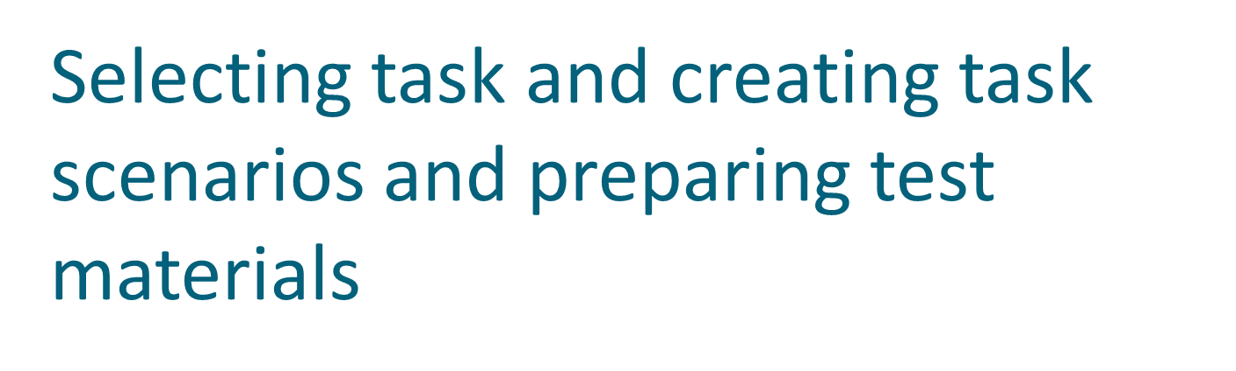

Slide 16
Predictive Evaluation
  Expert Analysis

Slide 17
Evaluation Through Expert Analysis
Evaluation should occur throughout the design process.
First, before any implementation work has started
Expensive mistakes can be avoided, if design itself evaluated
It can be expensive to carry out user testing at regular intervals during the design process and difficult to get an accurate assessment of the experience of interaction from incomplete design and prototpes.

Slide 18
Evaluation Through Expert Analysis
Consequently, a number of methods have been proposed to evaluate interactive system through expert analysis
Depends on the designer, or a human factors expert
Approaches of expert analysis:

Slide 19
Cognitive Walkthrough
Heuristic Evaluation

Slide 20
Cognitive Walkthrough
Proposed by Polson et al.
  An attempt to introduce psychological theory into the informal and subjective walkthrough technique.
  Origin of cognitive walkthrough approach to evaluation – code walkthrough
  Walkthrough requires a detailed review of a sequence of actions

Slide 21
Cognitive Walkthrough
Proposed by Polson et al.
  An attempt to introduce psychological theory into the informal and subjective walkthrough technique.
  Evaluates design on how well it supports the user in the learning task
  Usually performed by an expert in cognitive psychology
  Expert ‘walks though’ design to identify potential problems using psychological principles
  Forms used to guide analysis

Slide 22
Cognitive walkthrough
  Usually, the main focus of the cognitive walkthrough is to establish how easy a system is to learn.
  Focus is on learning through exploration.
  To do walkthrough you need four things:
    A description of the prototype of the system. It doesn’t have to be complete, but it should be fairly detailed. Details such as the location and wording for a menu can make a big difference.
    A description of the task the user is to perform on the system
    A complete, written list of the actions needed to complete the task with given prototype.
    An indication of who the users are and what kind of experience and knowledge the evaluators can assume about them.

Slide 23
Cognitive walkthrough
  Given this information,
    The evaluator step through action sequence to critique the system.
    To do this for each action,
    The evaluator try to answer the four questions on next slide for each step in the action sequence.

Slide 24
Cognitive walkthrough
For each actions evaluators try to answer the following four question:
Will the user be trying to produce whatever effect the action has?
Will user be able to notice that the correct action is available?
Once users find the correct action at the interface, will they know that it is right one for the effect they are trying to produce?
After the action is taken, will user understand the feedback they get?

Slide 25
Example: programming a video recorder by remote control
Imagine designing a remote control and are interested in task of programming to do timed recording. Initial design is shown in the paper given, the picture on the left illustrates the handset in normal use, the picture on the right after timed record button has been pressed. The remote control allows the user to program up to the three timed recordings in different ‘streams’. The next available stream number is automatically assigned. We want to know whether our design supports the user’s task

Slide 26
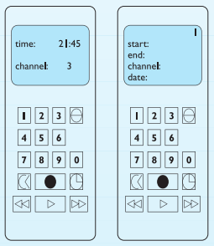
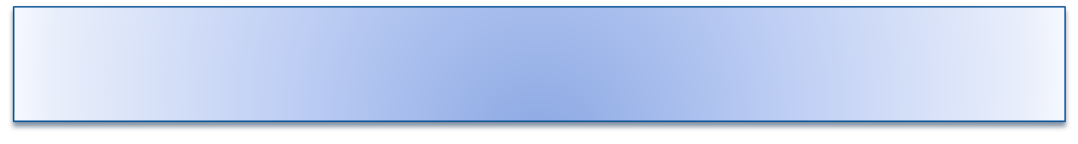
Program the video to time-record a program starting at 18.00 and finishing at 19.15 on channel 4 on Feb 2, 2021
The next step in the walkthrough is to identify the action sequence for this task. We specify this in terms of the user’s action (UA) and the system’s display or response (SD). The initial display is as the left-hand picture in Figure

Slide 27
UA 1: Press the ‘timed record’ button
SD 1: Display moves to timer mode. Flashing cursor appears after ‘start:’
UA 2: Press digits 1 8 0 0
SD 2: Each digit is displayed as typed and ﬂashing cursor moves to next position
UA 3: Press the ‘timed record’ button
SD 3: Flashing cursor moves to ‘end:’
UA 4: Press digits 1 9 1 5
SD 4: Each digit is displayed as typed and ﬂashing cursor moves to next position
UA 5: Press the ‘timed record’ button
SD 5: Flashing cursor moves to ‘channel:’
UA 6: Press digit 4
SD 6: Digit is displayed as typed and ﬂashing cursor moves to next position
UA 7: Press the ‘timed record’ button
SD 7: Flashing cursor moves to ‘date:’
UA 8: Press digits 2 4 0 2 0 5
SD 8: Each digit is displayed as typed and ﬂashing cursor moves to next position
UA 9: Press the ‘timed record’ button
SD 9: Stream number in top right-hand corner of display ﬂashes
UA 10: Press the ‘transmit’ button
SD 10: Details are transmitted to video player and display returns to normal mode

Slide 28
Having determined our action list we are in a position to proceed with the walkthrough. For each action (1–10) we must answer the four questions and tell a story about the usability of the system. Beginning with UA 1:

Slide 29
UA 1: Press the ‘timed record’ button
Question 1: Is the effect of the action the same as the user’s goal at that point?
The timed record button initiates timer programming. It is reasonable to assume that a user
familiar with remote control would be trying to do this as his ﬁrst goal.
Question 2: Will users see that the action is available?
The ‘timed record’ button is visible on the remote control.
Question 3: Once users have found the correct action, will they know it is the one they need?
It is not clear which button is the ‘timed record’ button. The icon of a clock (fourth button
down on the right) is a possible candidate but this could be interpreted as a button to change
the time. Other possible candidates might be the fourth button down on the left or the ﬁlled
circle (associated with record). In fact, the icon of the clock is the correct choice but it is quite
possible that the user would fail at this point. This identiﬁes a potential usability problem.
Question 4: After the action is taken, will users understand the feedback they get?
Once the action is taken the display changes to the timed record mode and shows familiar headings (start, end, channel, date). It is reasonable to assume that the user would recognize these as indicating successful completion of the ﬁrst action.

Slide 30
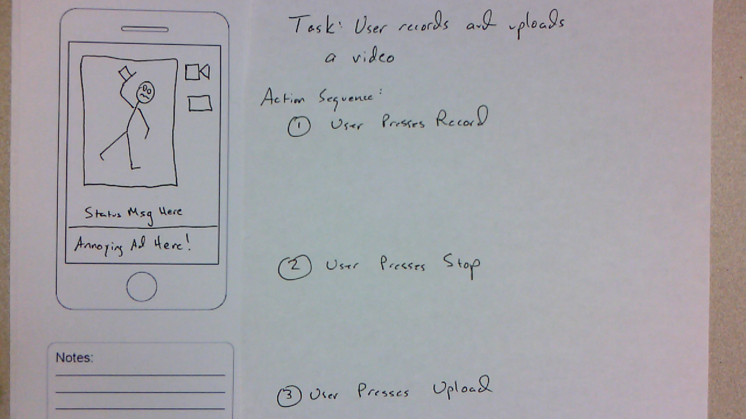

Slide 31
Heuristic Evaluation
Proposed by Nielsen and Molich.
usability criteria (heuristics) are identified
design examined by experts to see if these are violated
Example heuristics
  system behaviour is predictable
  system behaviour is consistent
  feedback is provided
Heuristic evaluation `debugs' design.

Slide 32
Nielsen’s heuristics
  1. visibility of system status – feedback
    The system should always keep users informed about what is going on, through appropriate feedback within reasonable time
    How does this apply to the Web?
      Answers for two key questions on every single page.
        Where am I?
        page title
        Where can I go?
        clearly visible navigation options
Notes:
. Visibility of system status - Feedback
The system should always keep users informed about what is going on, through appropriate feedback within reasonable time.
2. Match between system and the real world - Speak the user’s language
The system should speak the users' language, with words, phrases and concepts familiar to the user, rather than system-oriented terms. Follow real-world conventions, making information appear in a natural and logical order.
3. User control and freedom - Clearly marked exits
Users often choose system functions by mistake and will need a clearly marked "emergency exit" to leave the unwanted state without having to go through an extended dialogue. Support undo and redo.
4. Consistency and standards
Users should not have to wonder whether different words, situations, or actions mean the same thing. Follow platform conventions.
5. Error prevention
Even better than good error messages is a careful design which prevents a problem from occurring in the first place.

Slide 33
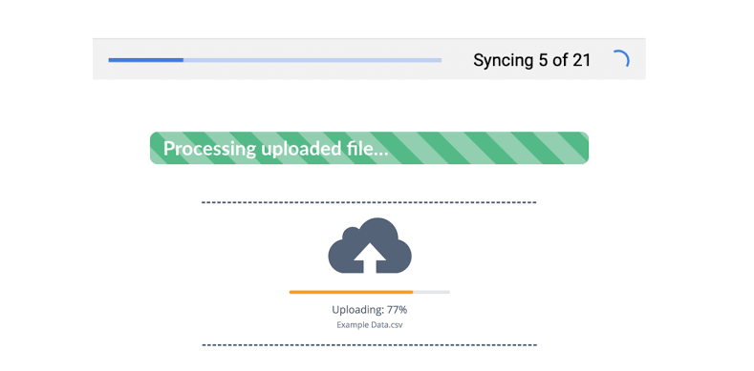

Slide 34
Nielsen’s heuristics
2. Match between system and the real world - Speak the user’s language
  The system should speak the users' language, with words, phrases and concepts familiar to the user, rather than system-oriented terms. Follow real-world conventions, making information appear in a natural and logical order.
  How does this apply to Web?
    Labels attached to the navigation options
    E.g. ‘add to basket’ on e-commerce site

Slide 35
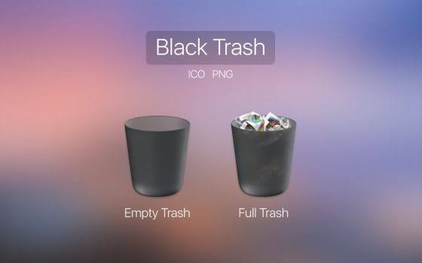

Slide 36
Nielsen’s heuristics
3. User control and freedom - Clearly marked exits
  Users often choose system functions by mistake and will need a clearly marked "emergency exit" to leave the unwanted state without having to go through an extended dialogue. Support undo and redo.
  How does this apply to Web?
    Back and forward buttons
    A link to the home page often provides emergency exit
    Navigation alternatives
      search and site maps

Slide 37
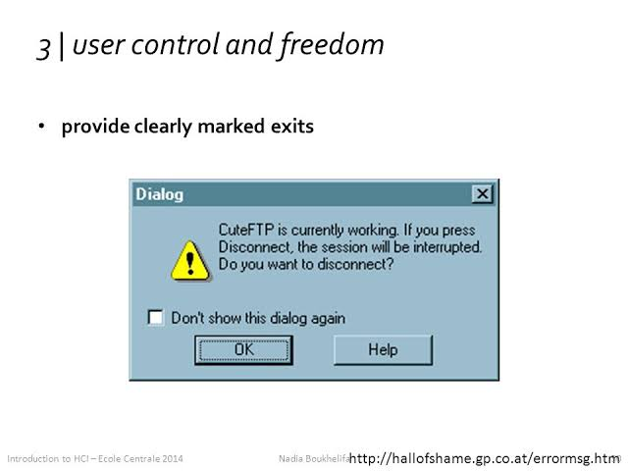

Slide 38
Nielsen’s heuristics
4. Consistency and standards
  Users should not have to wonder whether different words, situations, or actions mean the same thing. Follow platform conventions.
  How does this apply to Web?
    Page titles should match the link labels.
    Persistent Navigation options should appear in the same place on every page and features the same options on every page.
    Site design should follow the conventions of the web e.g. underline text is a link

Slide 39
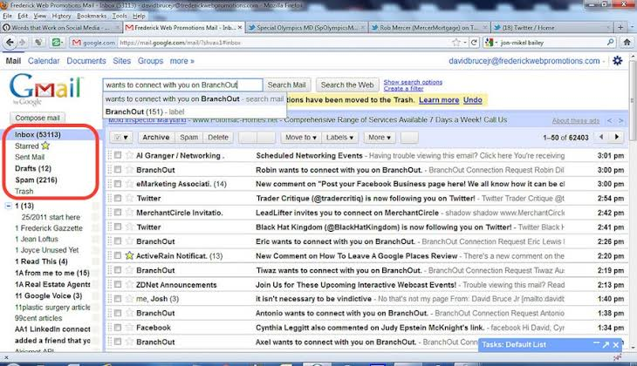

Slide 40
Nielsen’s heuristics
5. Error prevention
  Even better than good error messages is a careful design which prevents a problem from occurring in the first place.
  How does this apply to Web?
    Often the level of interaction on the web is less complex than in software applications. An iterative approach to design should reveal possible causes of errors such as 'dead end pages' or confusing HTML forms.

Slide 41
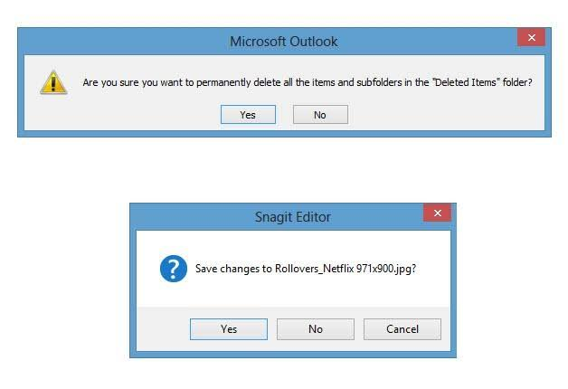

Slide 42
Nielsen’s heuristics
6. Recognition rather than recall - Minimise the user’s memory load
  Make objects, actions, and options visible. The user should not have to remember information from one part of the dialogue to another. Instructions for use of the system should be visible or easily retrievable whenever appropriate.
  How does the apply to Web?
      ‘greying out’ the currently selected navigation option

Slide 43
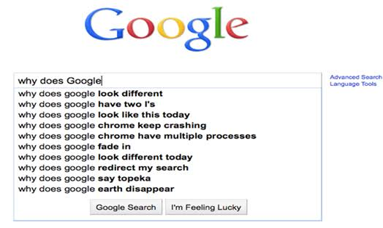
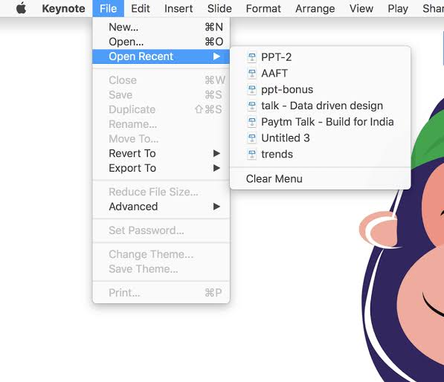

Slide 44
Nielsen’s heuristics
7. Flexibility and efficiency of use - Shortcuts
  Accelerators -- unseen by the novice user -- may often speed up the interaction for the expert user such that the system can cater to both inexperienced and experienced users. Allow users to tailor frequent actions.
  How does this apply to the web?
    Example would be Amazon’s ‘one click’ shopping.

Slide 45
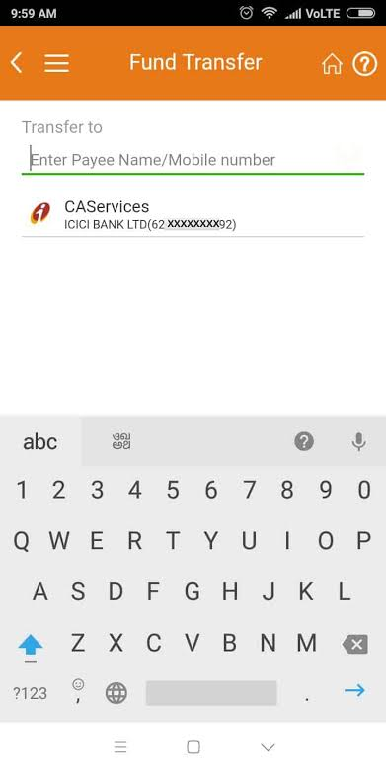

Slide 46
Nielsen’s heuristics
8. Aesthetic and minimalist design - Simple & natural dialogue
  Dialogues should not contain information which is irrelevant or rarely needed. Every extra unit of information in a dialogue competes with the relevant units of information and diminishes their relative visibility.
  How does this apply to Web?
    Every page should be necessary and have a purpose.
    Unnecessary graphics distracts the user from their task and increase download times

Slide 47
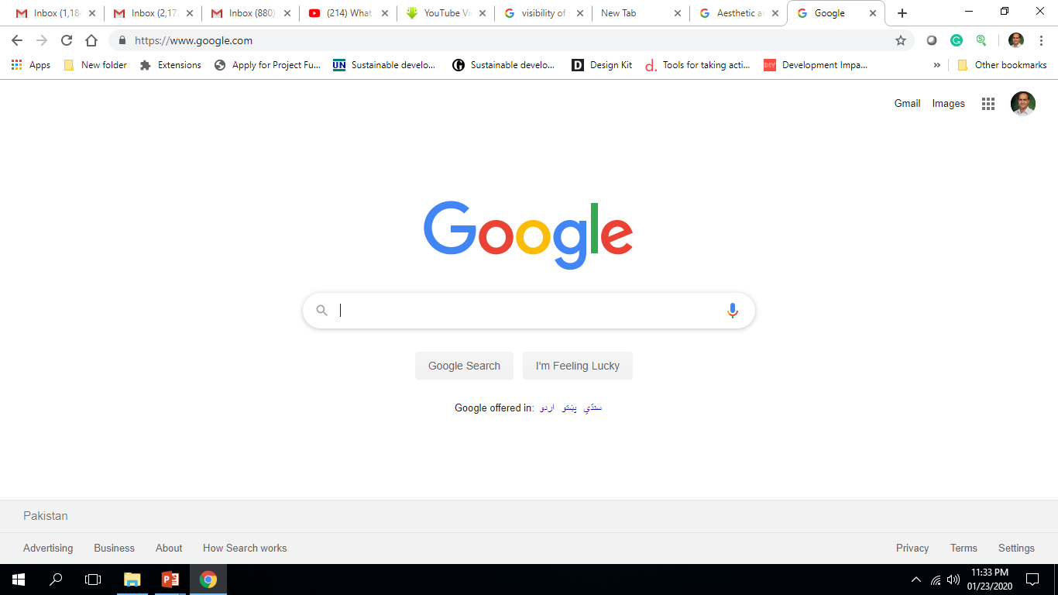

Slide 48
Nielsen’s heuristics
9.Help users recognise, diagnose, and recover from errors - Good error messages
  Error messages should be expressed in plain language (no codes), precisely indicate the problem, and constructively suggest a solution.
  How does this apply to Web?
    An example would be if a user filled in an HTML form incorrectly. The system should clearly indicate which fields were filled in incorrectly and why.

Slide 49
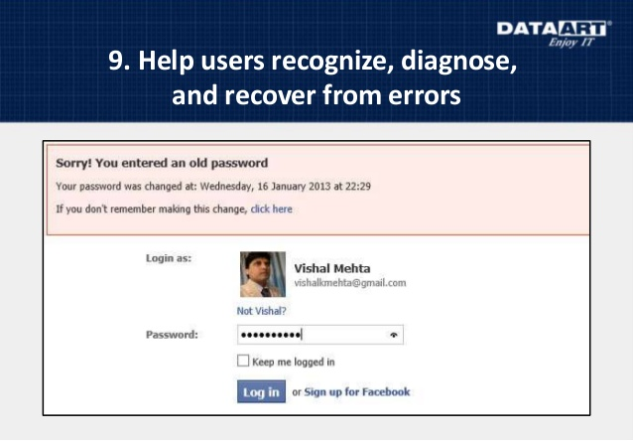

Slide 50
Nielsen’s heuristics
10. Help and documentation
  Even though it is better if the system can be used without documentation, it may be necessary to provide help and documentation. Any such information should be easy to search, focused on the user's task, list concrete steps to be carried out, and not be too large.
  How does this apply to Web?
    Simple web sites will not need any help and documentation. Those web sites that do should make help easily accessible and follow the guidelines described above.

Slide 51
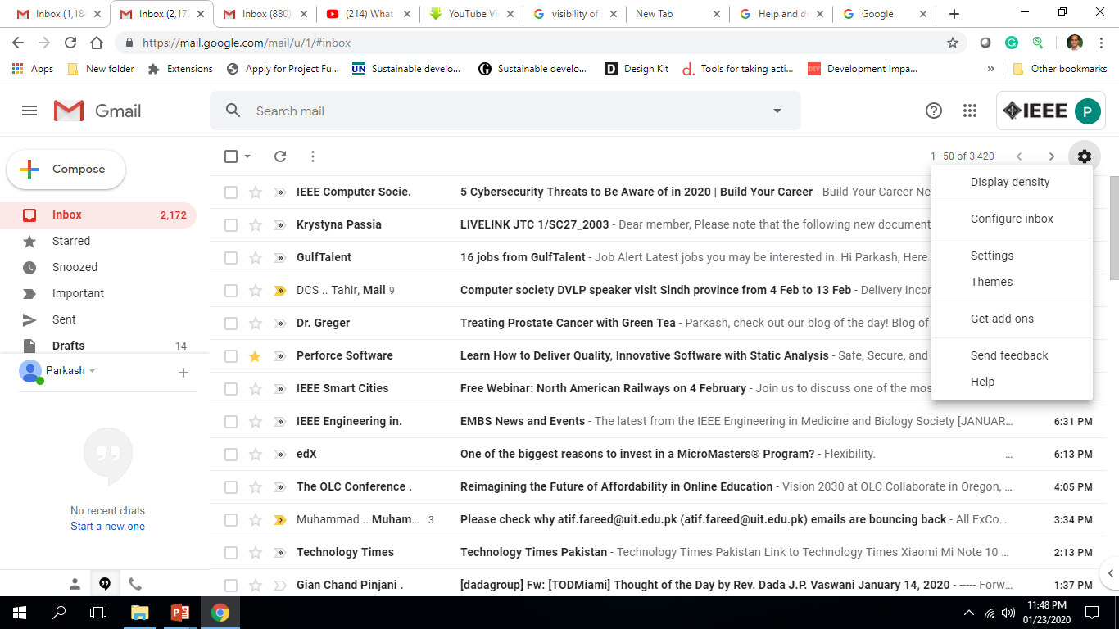

Slide 52
How to Carry out a Heuristic evaluation
The following shows an example of a section of a findings report for a fictitious web site
Visibility of System Status
  Some aspects of this are good all pages have titles and the consistent site logo clearly tells the user which site they are in.
Problem (severity rating=High)
  At the deeper levels of the site the user has no way of telling where they are. Which section they are currently in or where they have come from to get to the current page
Recommendation
  Some kind of 'You are here indicator' on the navigation bar that would clearly indicate which section of the site the user is visiting.
Problem (severity rating=Low)
  The page title is small and doesn't immediately stand out as the most important element on the page.
Recommendation
  Increase the font size of the page title. This will be easy to do without greatly effecting other page elements.

